Slide 1

Advanced Functions and Debugging
Powerful and scary

Slide 2
Topics
Introduction: GUI and basic calculations
Coding 1: Scripts, style, and variable classes
Coding 2: Control statements and loops
Visualization 1: Basics, subplots, get and set
Coding 3: Functions
Visualization 2: Descriptive plots
Coding 4: Basic input and output
Visualization 3: Distribution and 3D plots
Coding 5: Input and output specials – last lecture before holidays
Machine Learning 1: Introduction and dimension reduction
Machine Learning 2: Clustering
Machine Learning 3: Classification
Coding 6: Efficiency and debugging basics
Coding 7: Advanced functions and debugging

Slide 3
Anonymous Functions
Functions can also be created as handles, usually in just one line
myFunc = @(input) usage(input);
mySquareFunc = @(x) x^2;
Multiple inputs are possible as well
myLineFunc = @(x,a,b) a*x+b;
They can be used like regular functions inside the script or larger function
Beware: They DO have access to the workspace they have been created in!
Starting in MATLAB 2017

Slide 4
Functions Input Parser
Instead of having necessary parameters to pass a function, we can use keys and values
E.g. “raincloud_plot(myData, 'box_on', 1, ‘connecting_lines’, 1)”
Mandatory and optional input can be differentiated and default values can be set
Input checks happen in the parsing with specified conditions for each parameter
Built-in or self-built anonymous functions possible

Slide 5
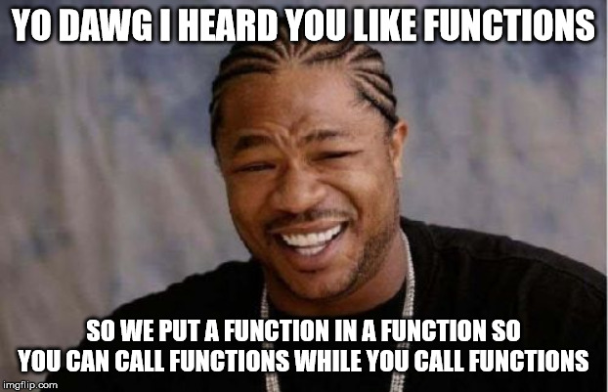
Hidden Functions
It is possible to create a function after another function in the same document
It will only be known to MATLAB from inside the first function!
It will also again have ist own workspace
Only use this if you are sure that only your larger function will ever make use of the hidden function!

